Slide 1
Multithreading Programming

Slide 2
Topics
Multithreading versus asynchronous programming
Multithreading in .NET Core
Threads in .NET Core
Thread synchronization
Lock
Monitor

Slide 3
Multithreading versus asynchronous programming
Multithreading refers to the practice of executing multiple threads at the same time to execute multiple operations or tasks in parallel. There could be one main thread and several background threads, usually known as worker threads, running in parallel at the same time, executing multiple tasks concurrently, whereas both synchronous and asynchronous operations can run on a single-threaded or a multithreaded environment.
In asynchronous programming, it is not always the case that each asynchronous operation will be running on a new thread. Async/Await is a good example of a situation where there is no additional thread created. The async operation is executed in the current synchronization context of the main thread and queues the asynchronous operation executed in the allocated time slice.

Slide 4
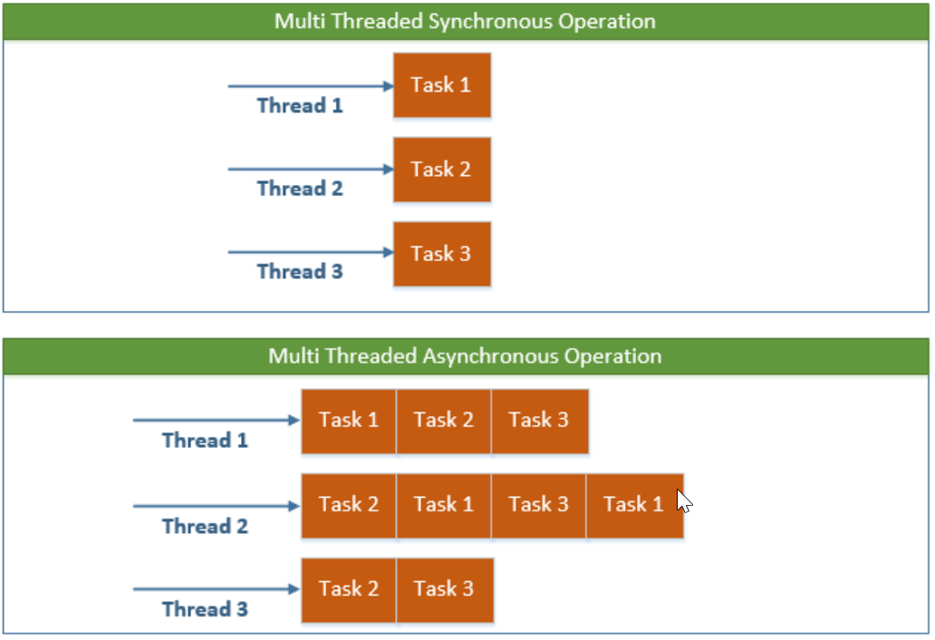
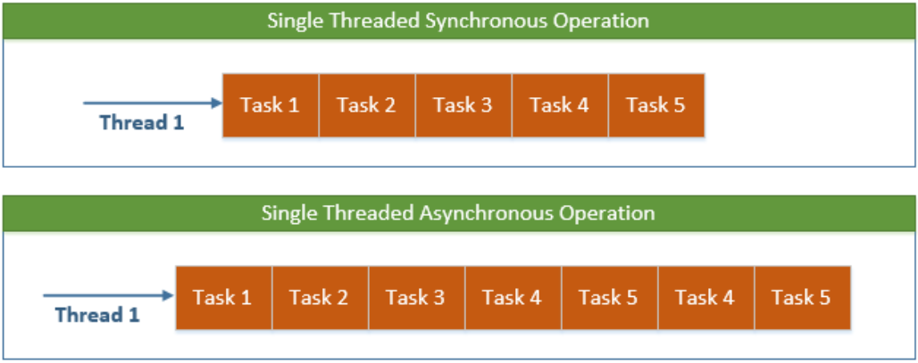

Slide 5
Multithreading in .NET Core
Here are some examples where multithreading is a good fit:
I/O operations
Running long-running background tasks
Database operations
Communicating over a network

Slide 6
Multithreading caveats
Although there are many benefits to multithreading, there are some caveats that need to be thoroughly addressed when writing multithreaded applications. If the machine is a single or two-core machine and the application is creating lots of threads, the context switching between these threads will slow the performance:
As far as the developer experience is concerned, debugging and testing are two other issues that are challenging for developers when creating a multithreaded application.

Slide 7
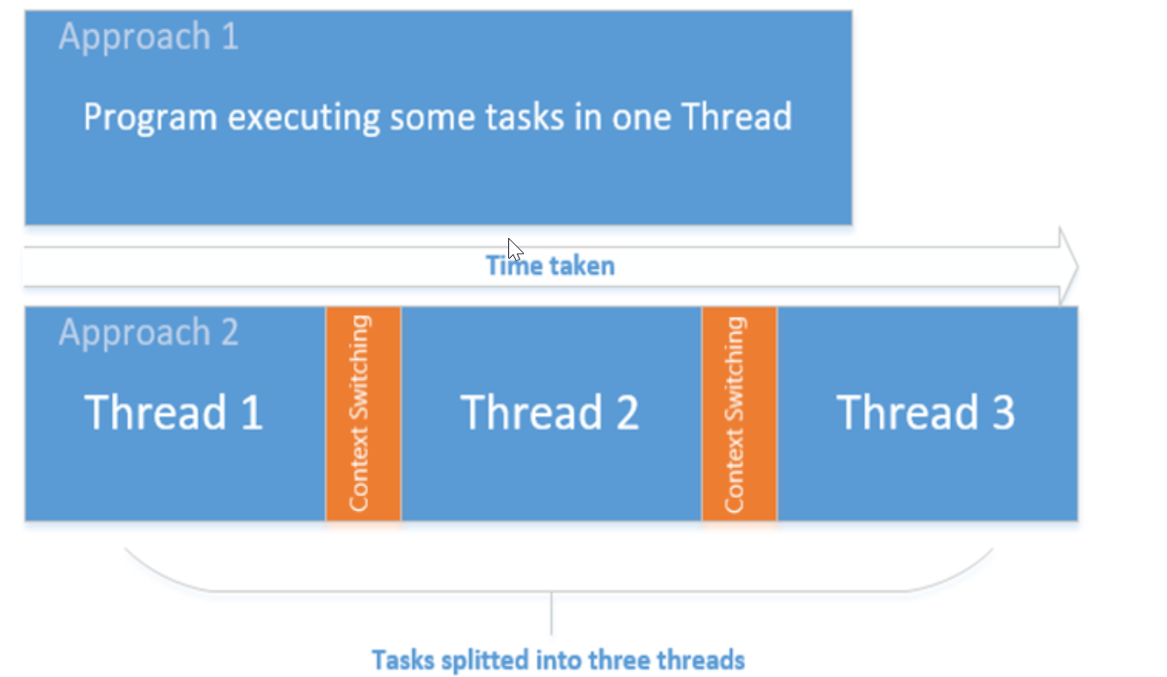
The preceding diagram depicts the program running on a single-processor machine. The first task executes synchronously, and runs comparatively faster than the three threads running on the single processor.

Slide 8
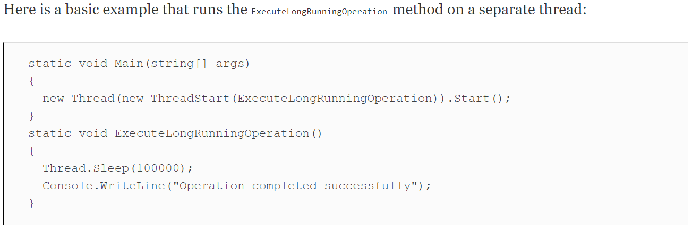
Creating threads in .NET Core
In .NET Core, the threading API is the same as that used in the full .NET Framework version. A new thread can be created by creating a Thread class object and passing the ThreadStart or ParameterizedThreadStart delegate as a parameter. ThreadStart and ParameterizedThreadStart wrap a method that is invoked when the new thread is started. ParameterizedThreadStart is used for method containing parameters.

Slide 9
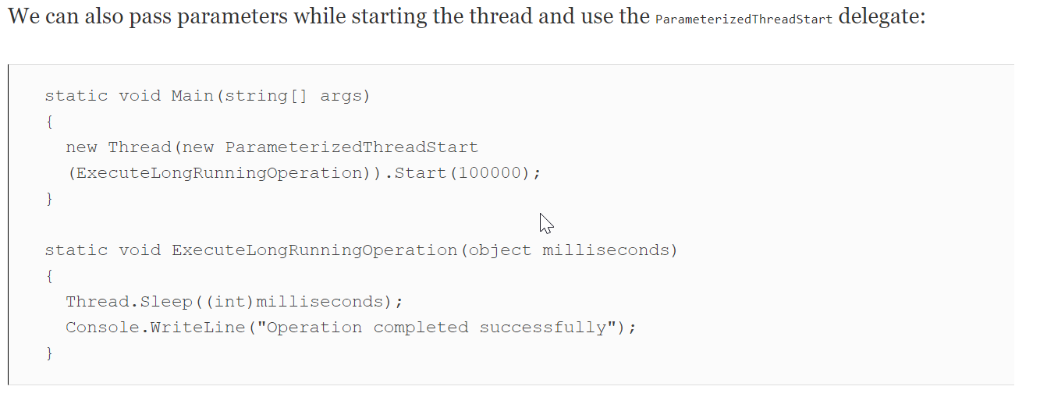

Slide 10
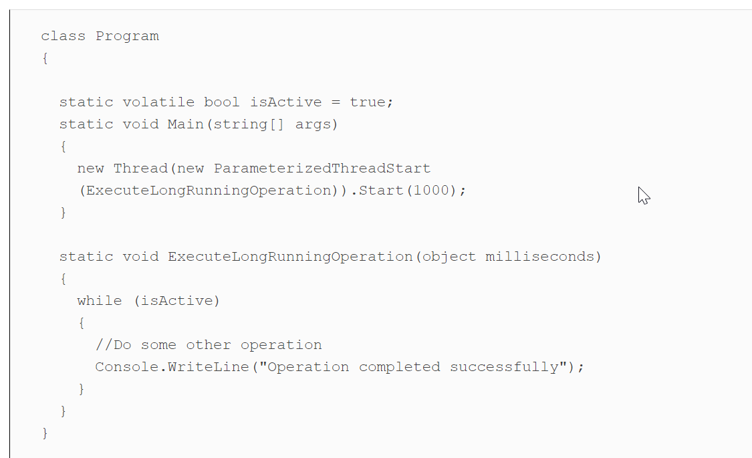
Thread lifetime
The lifetime of the thread depends on the method executing within that thread. Once the method is executed, CLR de-allocates the memory taken by the thread and disposes of. On the other hand, the thread can also be disposed of explicitly by calling the Interrupt or Abort methods.Another very important factor to consider is exceptions. If the exceptions are not properly handled within a thread, they are propagated to the calling method and so on until they reach the root method in the call stack. When it reaches this point, CLR will shut down the thread if it is not handled.For continuous or long-running threads, the shutdown process should be properly defined. One of the best approaches to smoothly shut down the thread is by using a volatile bool variable:

Slide 11
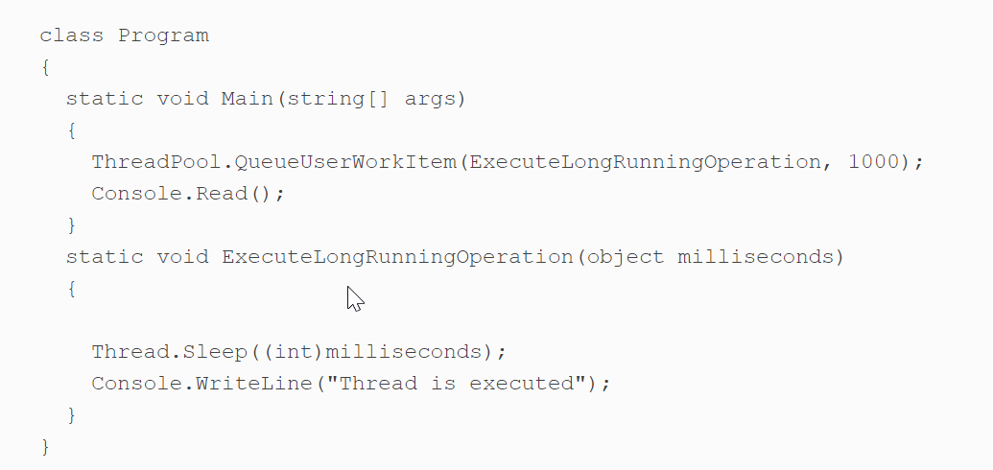
The thread pool in .NET
CLR provides a separate thread pool that contains the list of threads to be used to execute tasks asynchronously. Each process has its own specific thread pool. CLR adds and removes threads in or from the thread pool.To run a thread using ThreadPool, we can use ThreadPool.QueueUserWorkItem, as shown in the following code:
QueueUserWorkItem queues the task to be executed by the CLR in a thread that is available in the thread pool. The task queues are maintained in First In, First Out (FIFO) order. However, depending on the thread's availability and the task job itself, the task completion may be delayed.

Slide 12
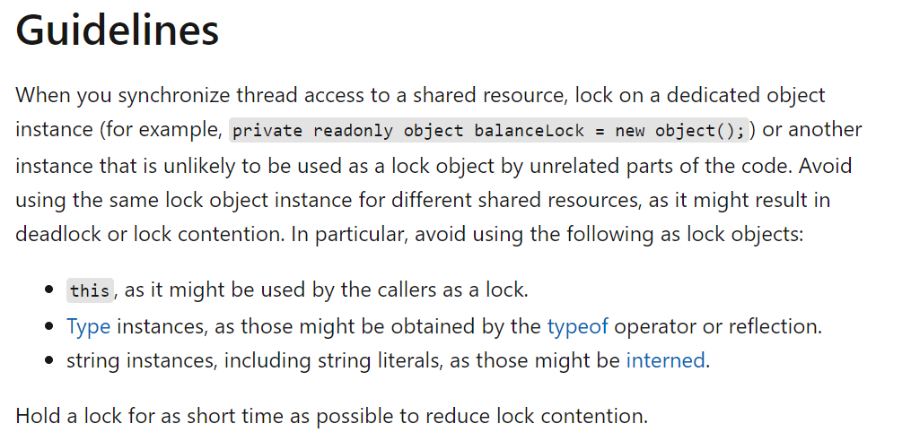
Thread synchronization - Lock
In multithreaded applications, we have shared resources that are accessible by multiple threads executing simultaneously. The area where the resources are shared across multiple threads is known as the critical section. To protect these resources and provide thread-safe access, there are certain techniques that we will discuss in this section.

Slide 13
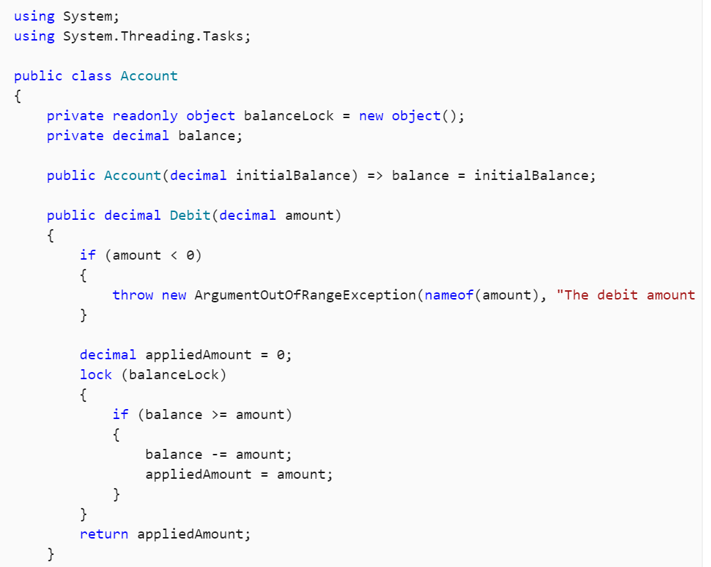

Slide 14
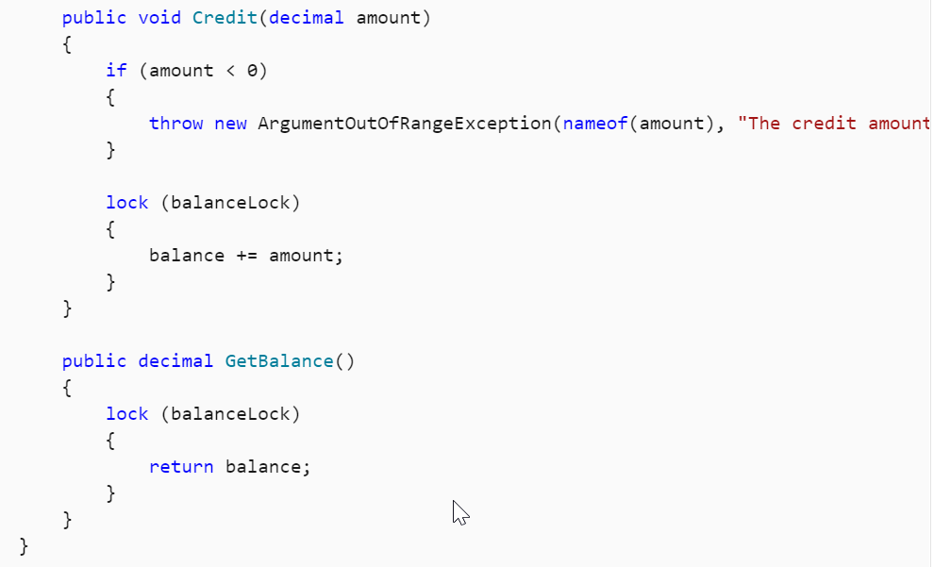

Slide 15
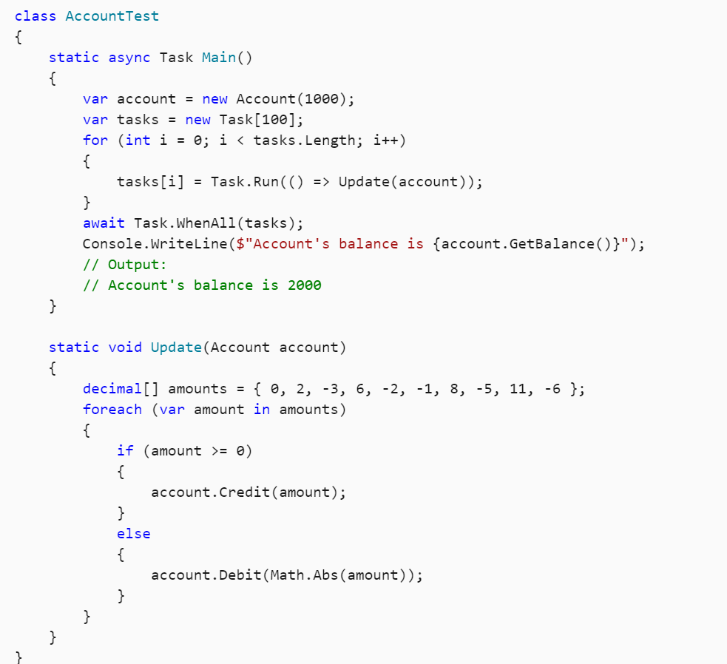

Slide 16
Monitors
If we look into the Monitor class, all the methods such as Monitor.Enter and Monitor.Exit operate on object references. Similarly to lock, Monitor also provides gated access to the resource; however, a developer will have greater control in terms of the API it provides.
To help us understand, let's take an example of a running Job whose task is to run the jobs added by multiple threads. If no job is present, it should wait for the threads to push and start executing them immediately.
In this example, we will create a JobExecutor class that runs in a separate thread. Here is the code snippet of JobExecutor:

Slide 17
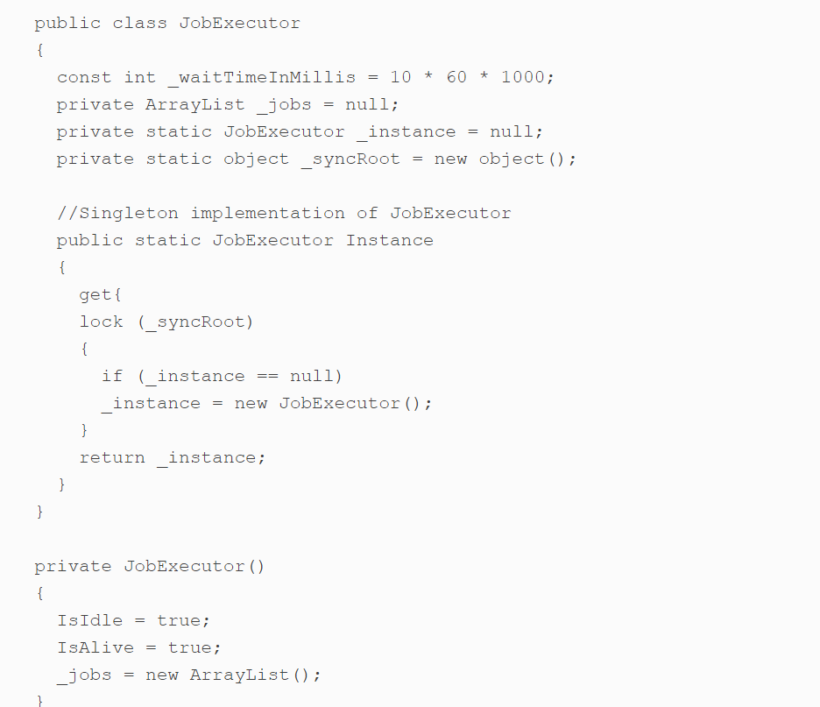

Slide 18
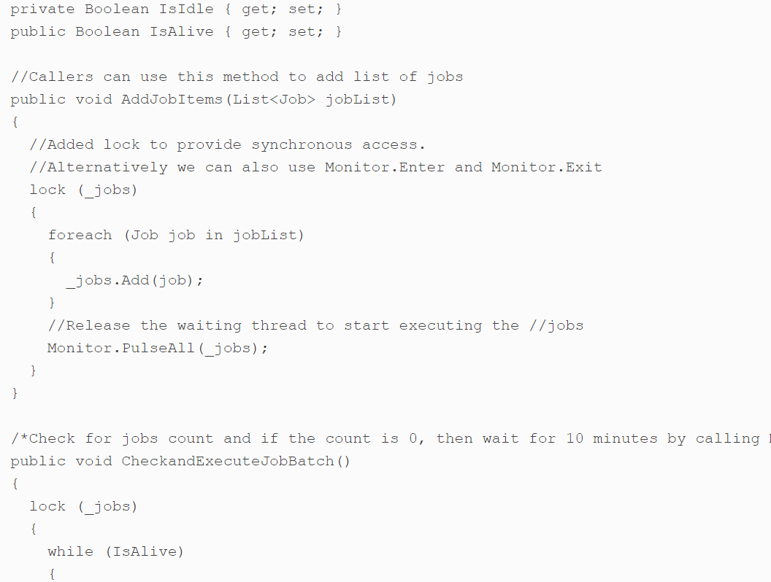

Slide 19
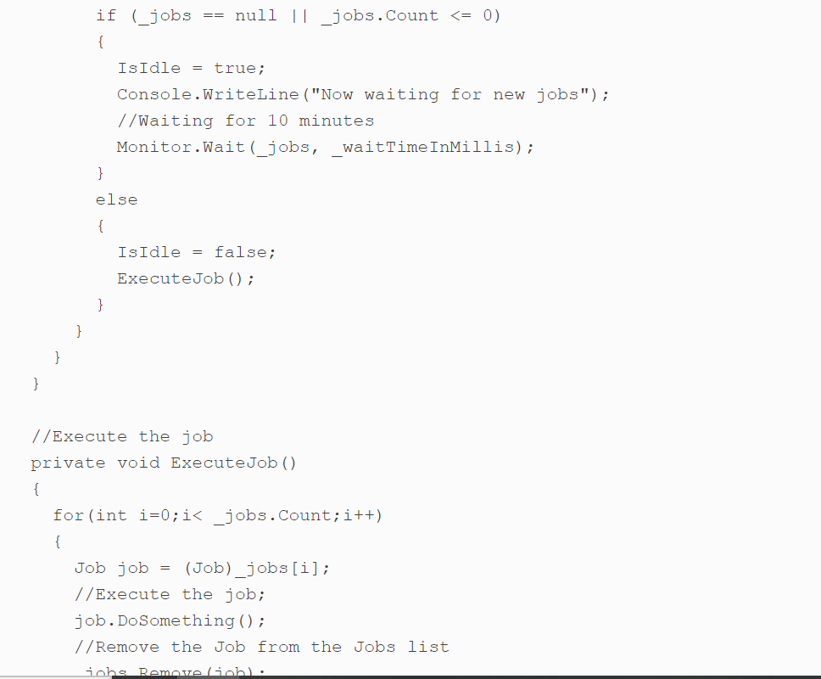
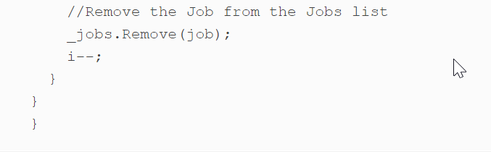

Slide 20
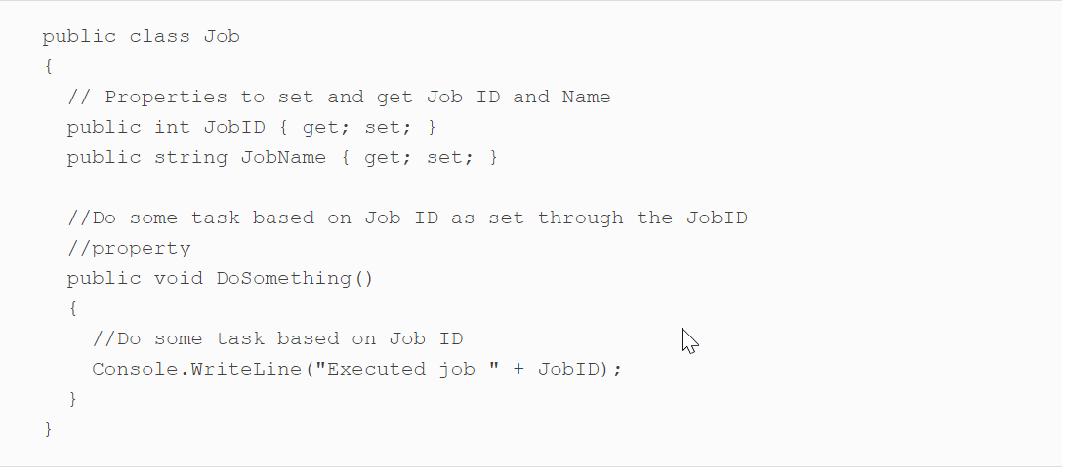
It's a singleton class, and other threads can access the JobExecutor instance using the static Instance property and call the AddJobsItems method to add the list of jobs to be executed. The CheckandExecuteJobBatch method runs continuously and checks for new jobs in the list every 10 minutes. Or, if it is interrupted by the AddJobsItems method by calling the Monitor.PulseAll method, it will immediately move to the while statement and check for the items count. If the items are present, the CheckandExecuteJobBatch method calls the ExecuteJob method that runs that job.Here is the code snippet of the Job class containing two properties, namely JobID and JobName, and the DoSomething method that will print the JobID on the console:

Slide 21
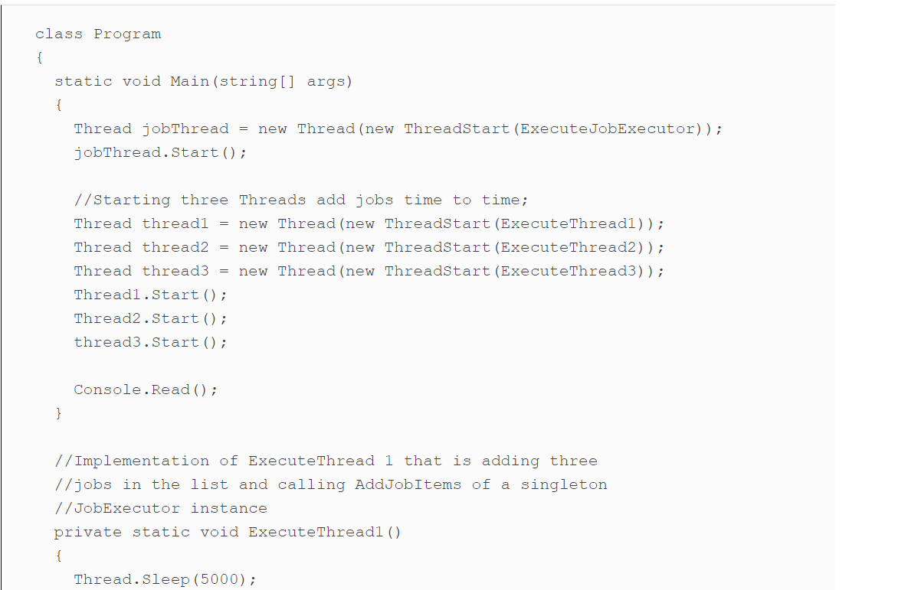
Finally, on the main Program class, we can invoke three worker threads and one thread for JobExecutor, as shown in the following code:

Slide 22
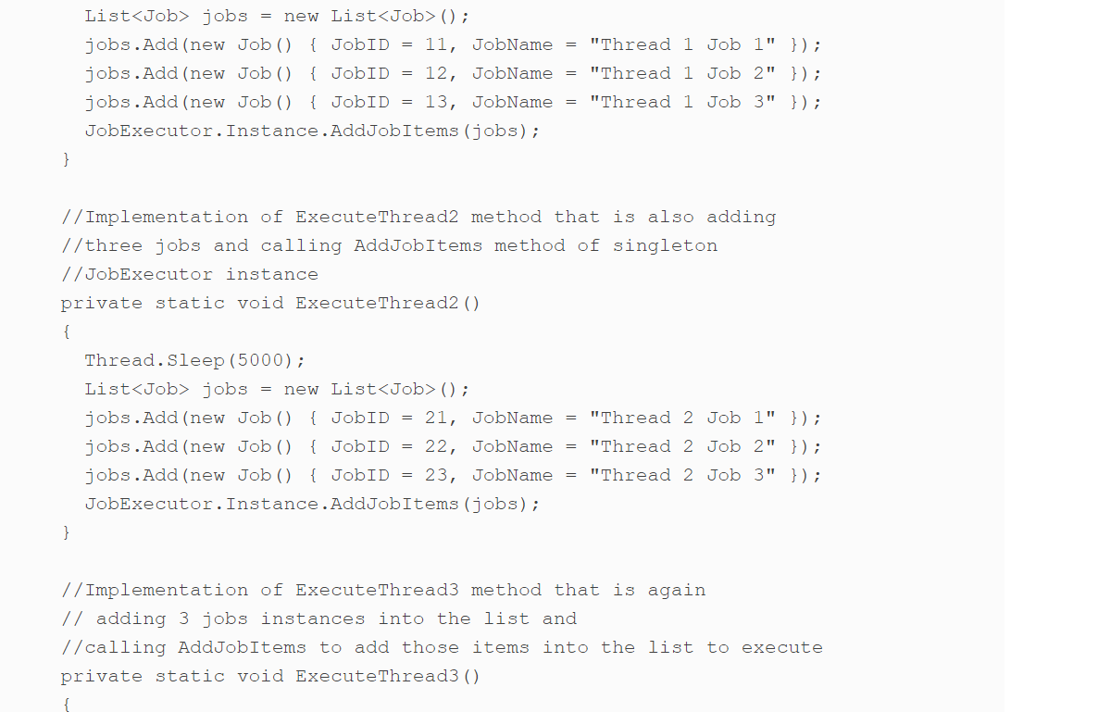

Slide 23
